Slide 1
Healthy Eating Assembly
Disclaimer: These slides were originally created by the British Nutrition Foundation (BNF) for Healthy Eating Week 2023. They have since been updated and adapted to help schools raise awareness about fibre intake and to highlight the different sources of dietary fibre.
Use slides 2-16 for 25minute assembly (here is link to the original recording of the primary-school assembly which schools may find useful to deliver the assembly https://www.youtube.com/watch?v=VI0jTGG-3sM )
Use slides 18-22 for 10minute class presentation on snacks
Use slides 23-25 for 20minute class activity using fibre cards
Considerations: The slides were prepared by British Nutrition Foundation and were modified to suit delivery of Healthy Eating assembly and workshop for Richmond and Wandsworth schools

Slide 2
Healthy Meals & snacks with focus on fibre!
Learning Objectives
To understand the significance of dietary fibre in maintaining digestive health and overall wellbeing.
To be able to identify foods rich in fibre, including wholegrains, fruit and vegetables, beans, peas, and lentils.
To recognise and recall the five key themes for healthy eating:
Focusing on fibre for meals and snacks
Getting at least 5 portions of fruit and vegetables a day
Varying protein sources, with an emphasis on plant proteins
Staying hydrated with healthier drink choices
Reducing food waste to help the planet
To identify practical steps that can be taken at school and home to support a healthier lifestyle and more sustainable food choices.
Aim of the Assembly
To empower children with the knowledge to make healthy food and drink choices, with a special emphasis on the importance of dietary fibre as part of a balanced diet.
5 key messages are:
Focus on fibre
Get 5-a-day
Vary your protein
Stay hydrated
Reduce food waste

Slide 3





There are five themes to help everyone eat well!
Healthy Meals & snacks with focus on fibre!
Let’s find out more!

Slide 4

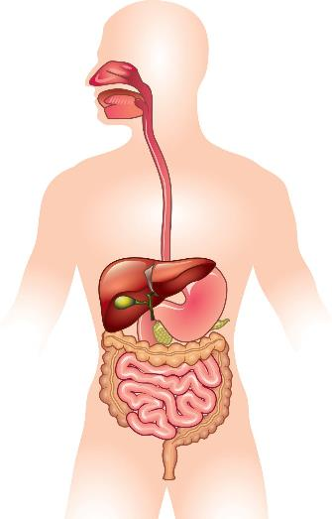
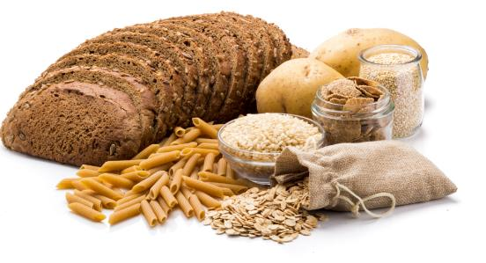
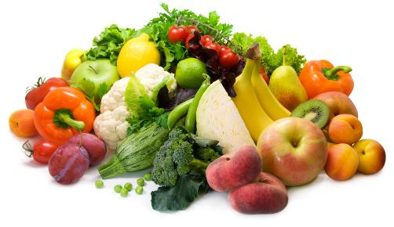
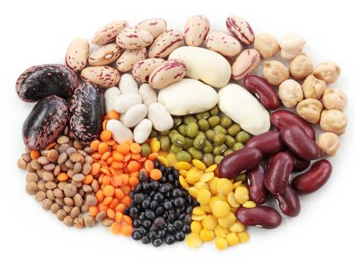
Focus on fibre – for meals and snacks
Why do we need fibre?
Where does fibre come from?
Wholegrain foods
Fruit and vegetables
To keep our digestive system healthy.
Beans, peas and lentils
Notes:
Dietary fibre is important for keeping the digestive system healthy. It can increase the bulk of stools and help them to pass through the intestines more quickly. This may help to reduce constipation. There is also an association between increased dietary fibre intake and a reduced risk of cardiovascular disease, colorectal cancer and type 2 diabetes.
The term ‘dietary fibre’ refers mostly to a broad group of carbohydrates which are not digested, nor absorbed in the small intestine
Makes you feel fuller for longer
Makes bulk of the stool
Food source for ‘good bacteria in our gut
Reduces constipation (make sure you drink plenty of water)
Reduces cholesterol (beta-glucans in oats and barley)
Certain types of fibre can also provide additional, specific benefits. Some types of dietary fibre can act as a food source for ‘good’ bacteria, helping them to increase in number and produce compounds that may have a benefit to human health.
Some fibre types (e.g. beta-glucans, a type of fibre found in grains such as oat and barley), have been shown to be able to help maintain normal cholesterol levels.
High-fibre foods provide a low amount of energy (calories) per gram. They may be able to keep people feeling fuller for longer, reducing overall energy (calorie) intake. There is some evidence to suggest that higher-fibre foods can aid with weight management

Slide 5
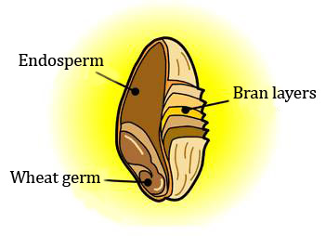
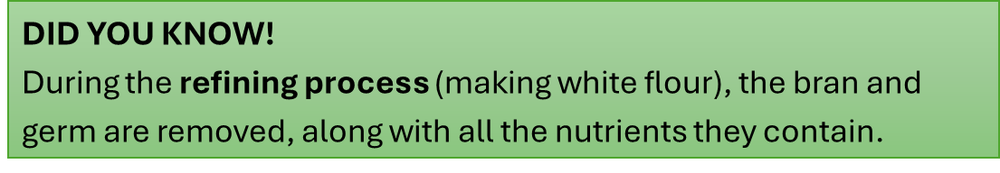
Wholegrains
(wholemeal, wholewheat)
A grain of wheat
A grain consists of:
the endosperm (the white flour);
the bran layers (outside case of the grain);
the wheat germ (part that grows a new plant).

Slide 6
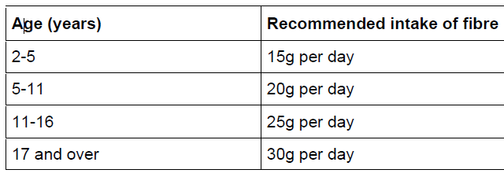
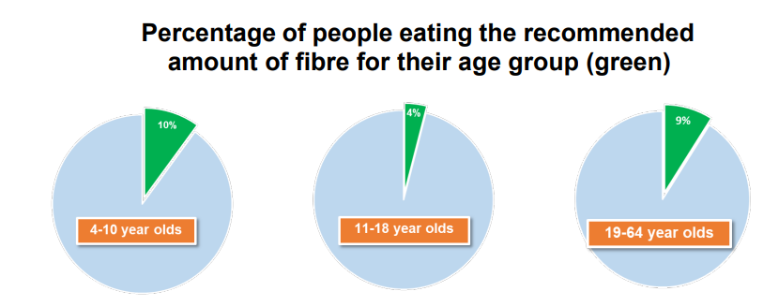
How much dietary fibre should we be consuming?
This means that only 10 out of 100 4-10 year olds and 4 out of 100 11-18 year olds eat the recommended amount of fibre!
Source: NDNS results from years 9 to11 (2016 – 2019)
Notes:
Majority of us do not eat the recommended amount of fibre.
If we had a group of 100 4-10 year olds only 10 of them would eat the recommended amount
If we had a group of 100 11-18 year olds only 4 of them would eat the recommended amount. For adults the story is very similar only 9 out of 100 adults eat the recommended amount.
The percentage not meeting their daily fibre recommendations ranges from 86-96%, which means that many people may not receive the benefits that come with consuming the recommended amount of fibre each day. Evidence also suggests that 18% of adults and 15% of children consume no wholegrains (such as wholewheat pasta, wholegrain bread and brown rice), which could be severely limiting their fibre intake. t of 100 adults eat the recommended amount.

Slide 7

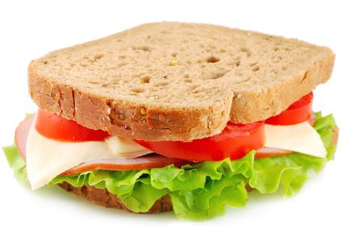

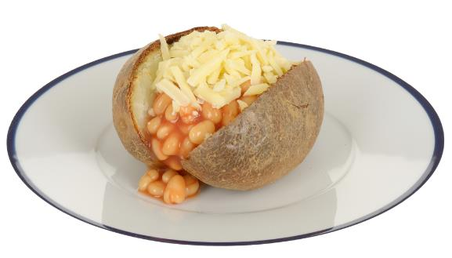

Find the fibre!
Where is the fibre in these dishes?
Foods that provide fibre
Wholemeal bread
Wholegrain foods
Tomato and lettuce
Fruit and vegetables
Potato with skin on
Beans
Beans, peas and lentils

Slide 8
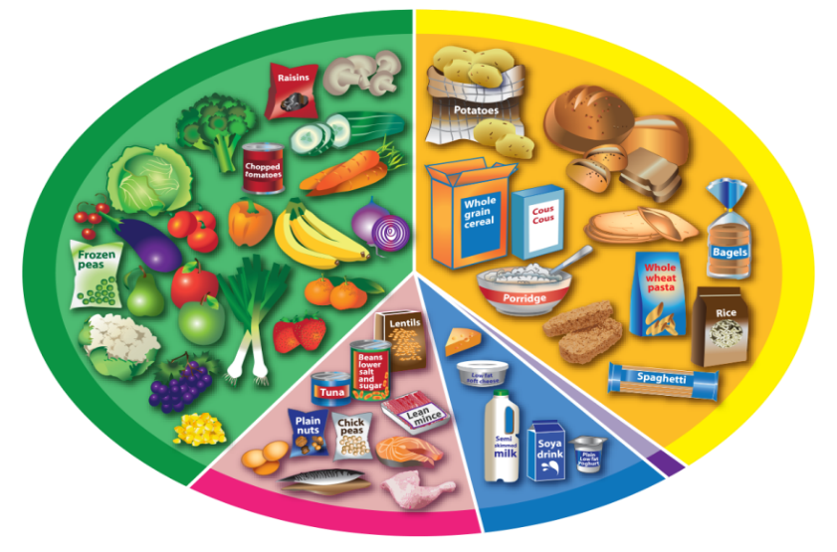
The Eatwell Guide
Foods that provide fibre
Where are the foods that provide fibre on the Eatwell Guide?
Wholegrain foods
Wow, fibre can be in all these foods!
Fruit and vegetables
Beans, peas and lentils

Slide 9


Get at least 5 A DAY
canned and frozen count too
How much do we need?
Why do we need fruit and vegetables?
At least 5 portions a day!
How much is a portion?
About what fits into the palm of your hand.
fibre!
For vitamins, minerals and...

Slide 10
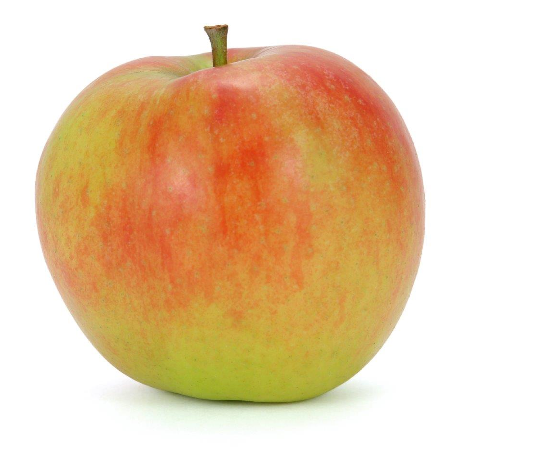
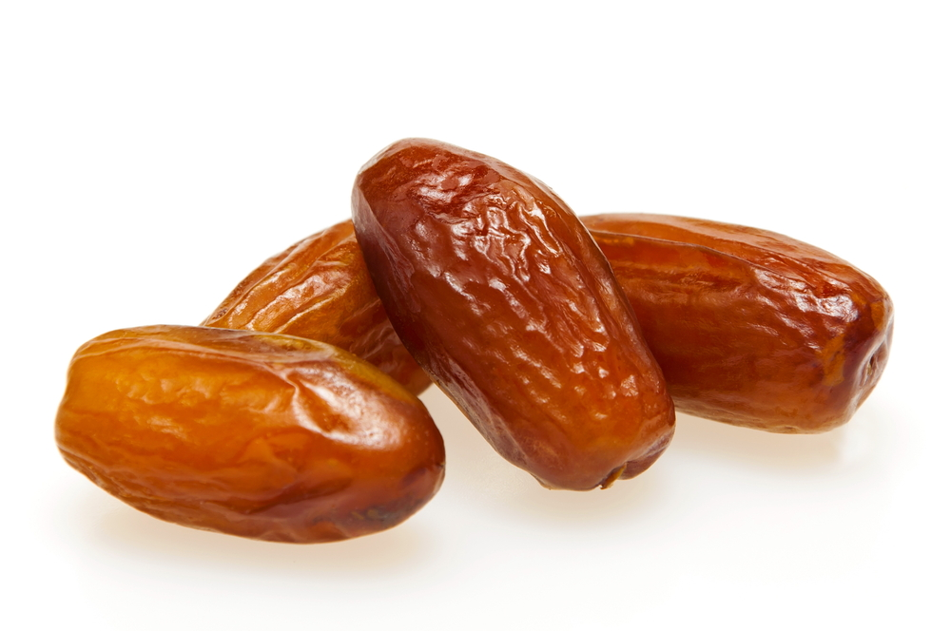
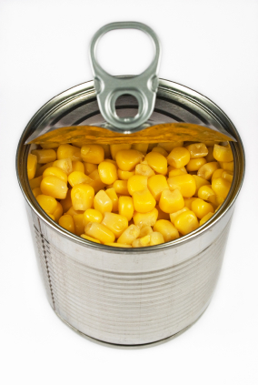
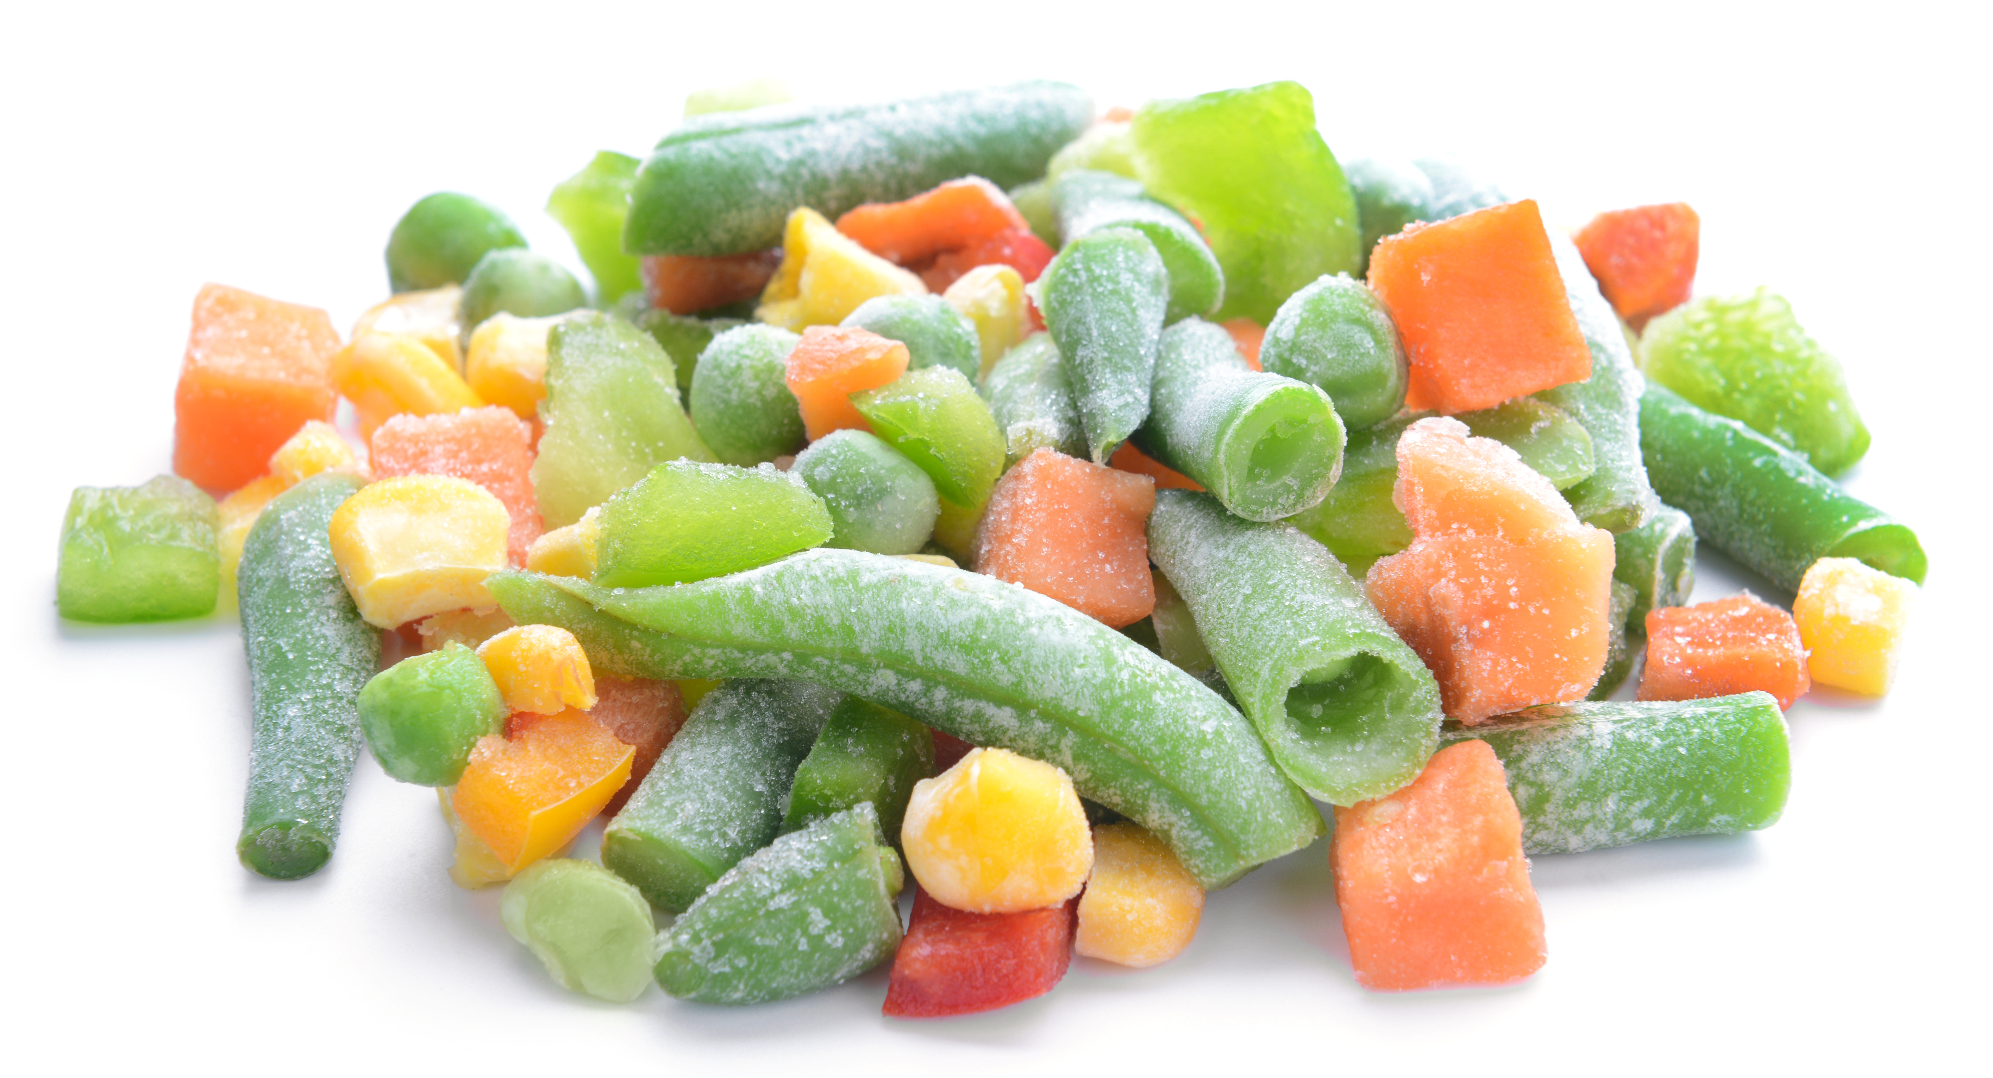
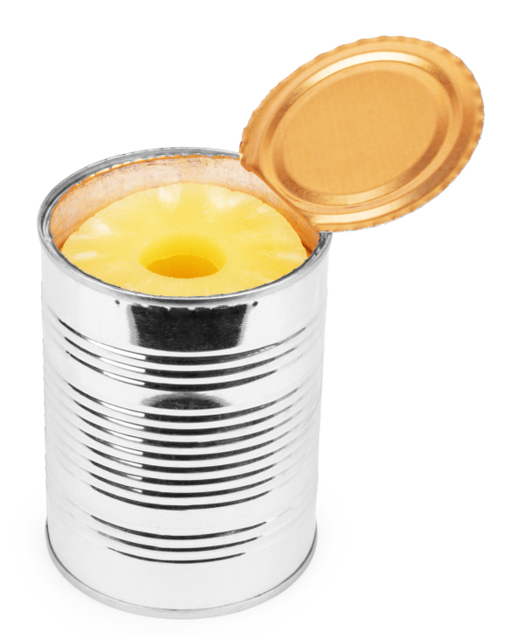


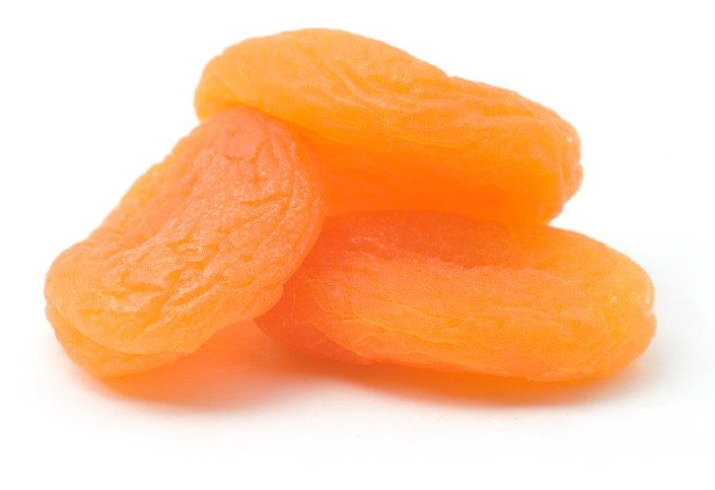
Get at least 5 A DAY
canned and frozen count too
What counts?
Canned and frozen types are handy because they can be ready in the freezer or cupboard at anytime!
Fresh, frozen, dried and canned all count.
Can you think of some examples for each type?
Fresh | Frozen | Dried | Canned
They can cost less too!

Slide 11

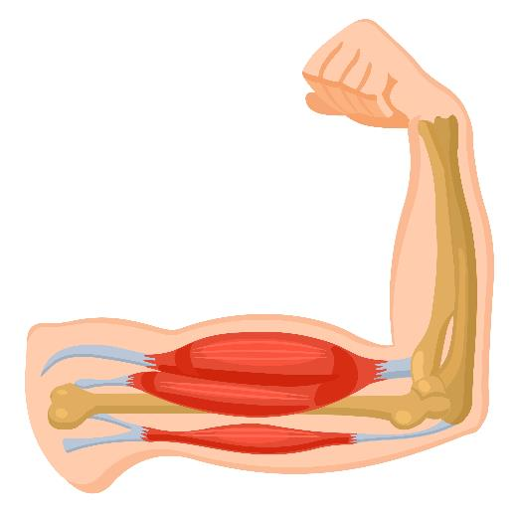
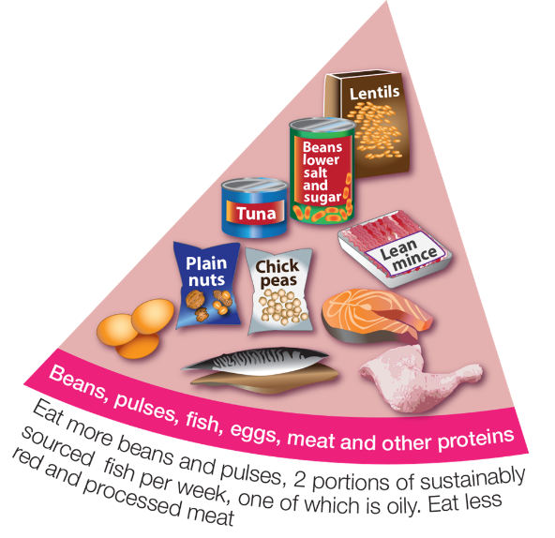
Vary your protein – be more creative
Why do we need protein foods?
What foods provide protein?
To help muscles and bones grow.
What foods can you see here?

Slide 12

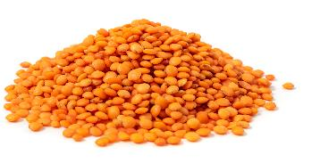
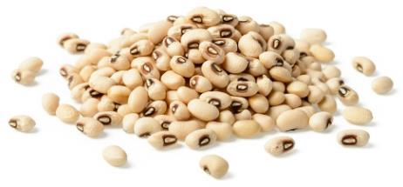
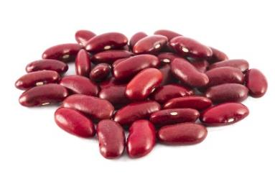
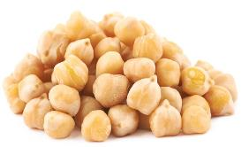
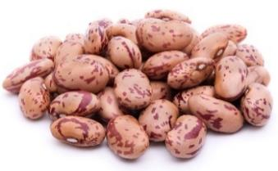
Vary your protein – be more creative
We should vary our protein and have protein foods from plants more often.
Can you name these protein foods from plants?
Red lentils
Black eyed beans
Red kidney beans
Which of these have you tried?
Chickpeas
Pinto beans

Slide 13



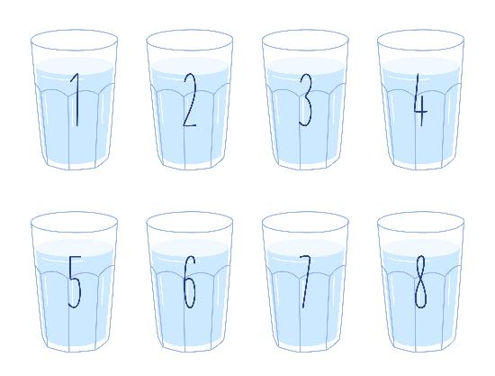

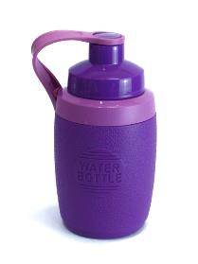


Stay hydrated – fill up from the tap
How much do we need to drink each day?
What are healthier drink choices?
Use reusable drink containers, like...
About 6-8 drinks a day.
or recyclable drink containers!

Slide 14
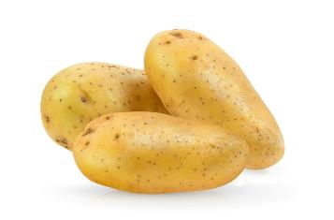

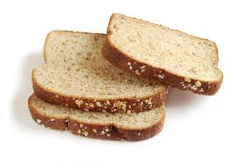

Reduce food waste – be food wise
What three foods do you think are wasted the most?
Why is it important to reduce food waste?
To look after our planet.
Land, water and energy are used to make our food. When food is wasted, it means these resources are wasted too.
To save money.
Potatoes, bread and milk.

Slide 15




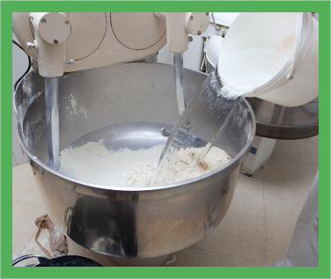
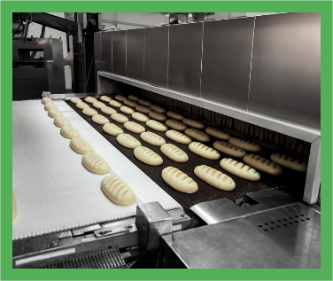
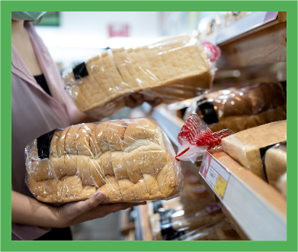
A lot goes into producing our food!
Land
Fuel
Transport
Water
Oven
Packaging

Slide 16
Our five key message are:
Thank you

Slide 17
30-Minute Class Workshop (What makes a good, healthy snack)
Aims to: help children understand what makes a snack suitable for school, with a particular focus on increasing fibre intake and making choices that align with the School Food Standards and the school’s Food Policy.
10-Minute Snack Presentation
20-Minute Practical Workshop
Aim: To raise awareness among pupils of the importance of selecting healthy snacks, specifically those that contribute to their daily fibre intake and are compliant with school snack guide/food policy.
Learning Objectives:
To recognise which snacks are suitable in general, and which are appropriate to bring to school according to the School Food Standards.
To identify the characteristics of a good snack, including high fibre content, affordability, being less processed, offering variety in texture, using less packaging, and being lower in sugar and salt.
To understand how snack choices support both good nutrition and the school’s Food Policy, including mid-morning snack guidelines.
Aim: To engage children in hands-on activities to deepen their understanding of fibre content in everyday foods, and to develop skills for making healthier snack choices through interactive group tasks.
Learning Objectives:
To use fibre cards to identify and categorise foods according to the relevant food groups on the Eatwell Guide.
To compare fibre content in fresh versus dried foods and understand the importance of hydration in a high-fibre diet.
To order foods by their fibre content using mathematical reasoning (comparing decimals), encouraging cross-curricular links with maths.
To discuss and challenge common misconceptions about fibre content in foods, and reflect on the benefits of eating a variety of fibre-rich foods to support our gut health.
To develop teamwork and communication skills through group activities, and to be able to explain the importance of fibre for digestive health and wellbeing.

Slide 18
Class activity - What makes a good, healthy snack
Notes:
Aim of the Session
The aim of this session is to help children understand what constitutes suitable snacks in general and, more specifically, which snacks are appropriate to bring to school in line with the mandatory School Food Standards.
Learning Objectives
To recognise the importance of choosing snacks that contribute to a healthy, balanced diet.
To identify examples of suitable snacks for school that comply with the School Food Standards.
To understand how snack choices can be aligned with the school’s Food Policy and mid-morning snack guidelines.
Instructions: Display the presentation on the class board. The session focuses on snacks and can be adapted to fit your school’s needs, linking it with your Food Policy and any policies regarding mid-morning snacks. The presentation should last no more than 10 minutes followed by a 20-minute practical workshop

Slide 19

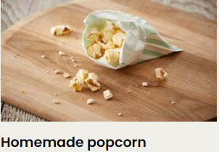
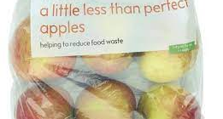

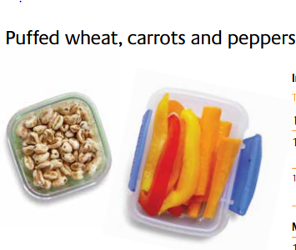
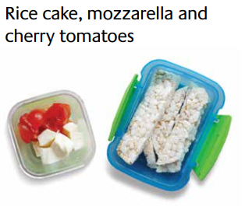
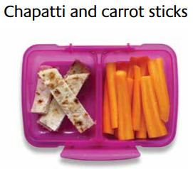
What makes a good snack?
Lower in sugar & salt
Not expensive
unprocessed
Fibre content is maintained
Variety of textures
Less packaging

Slide 20

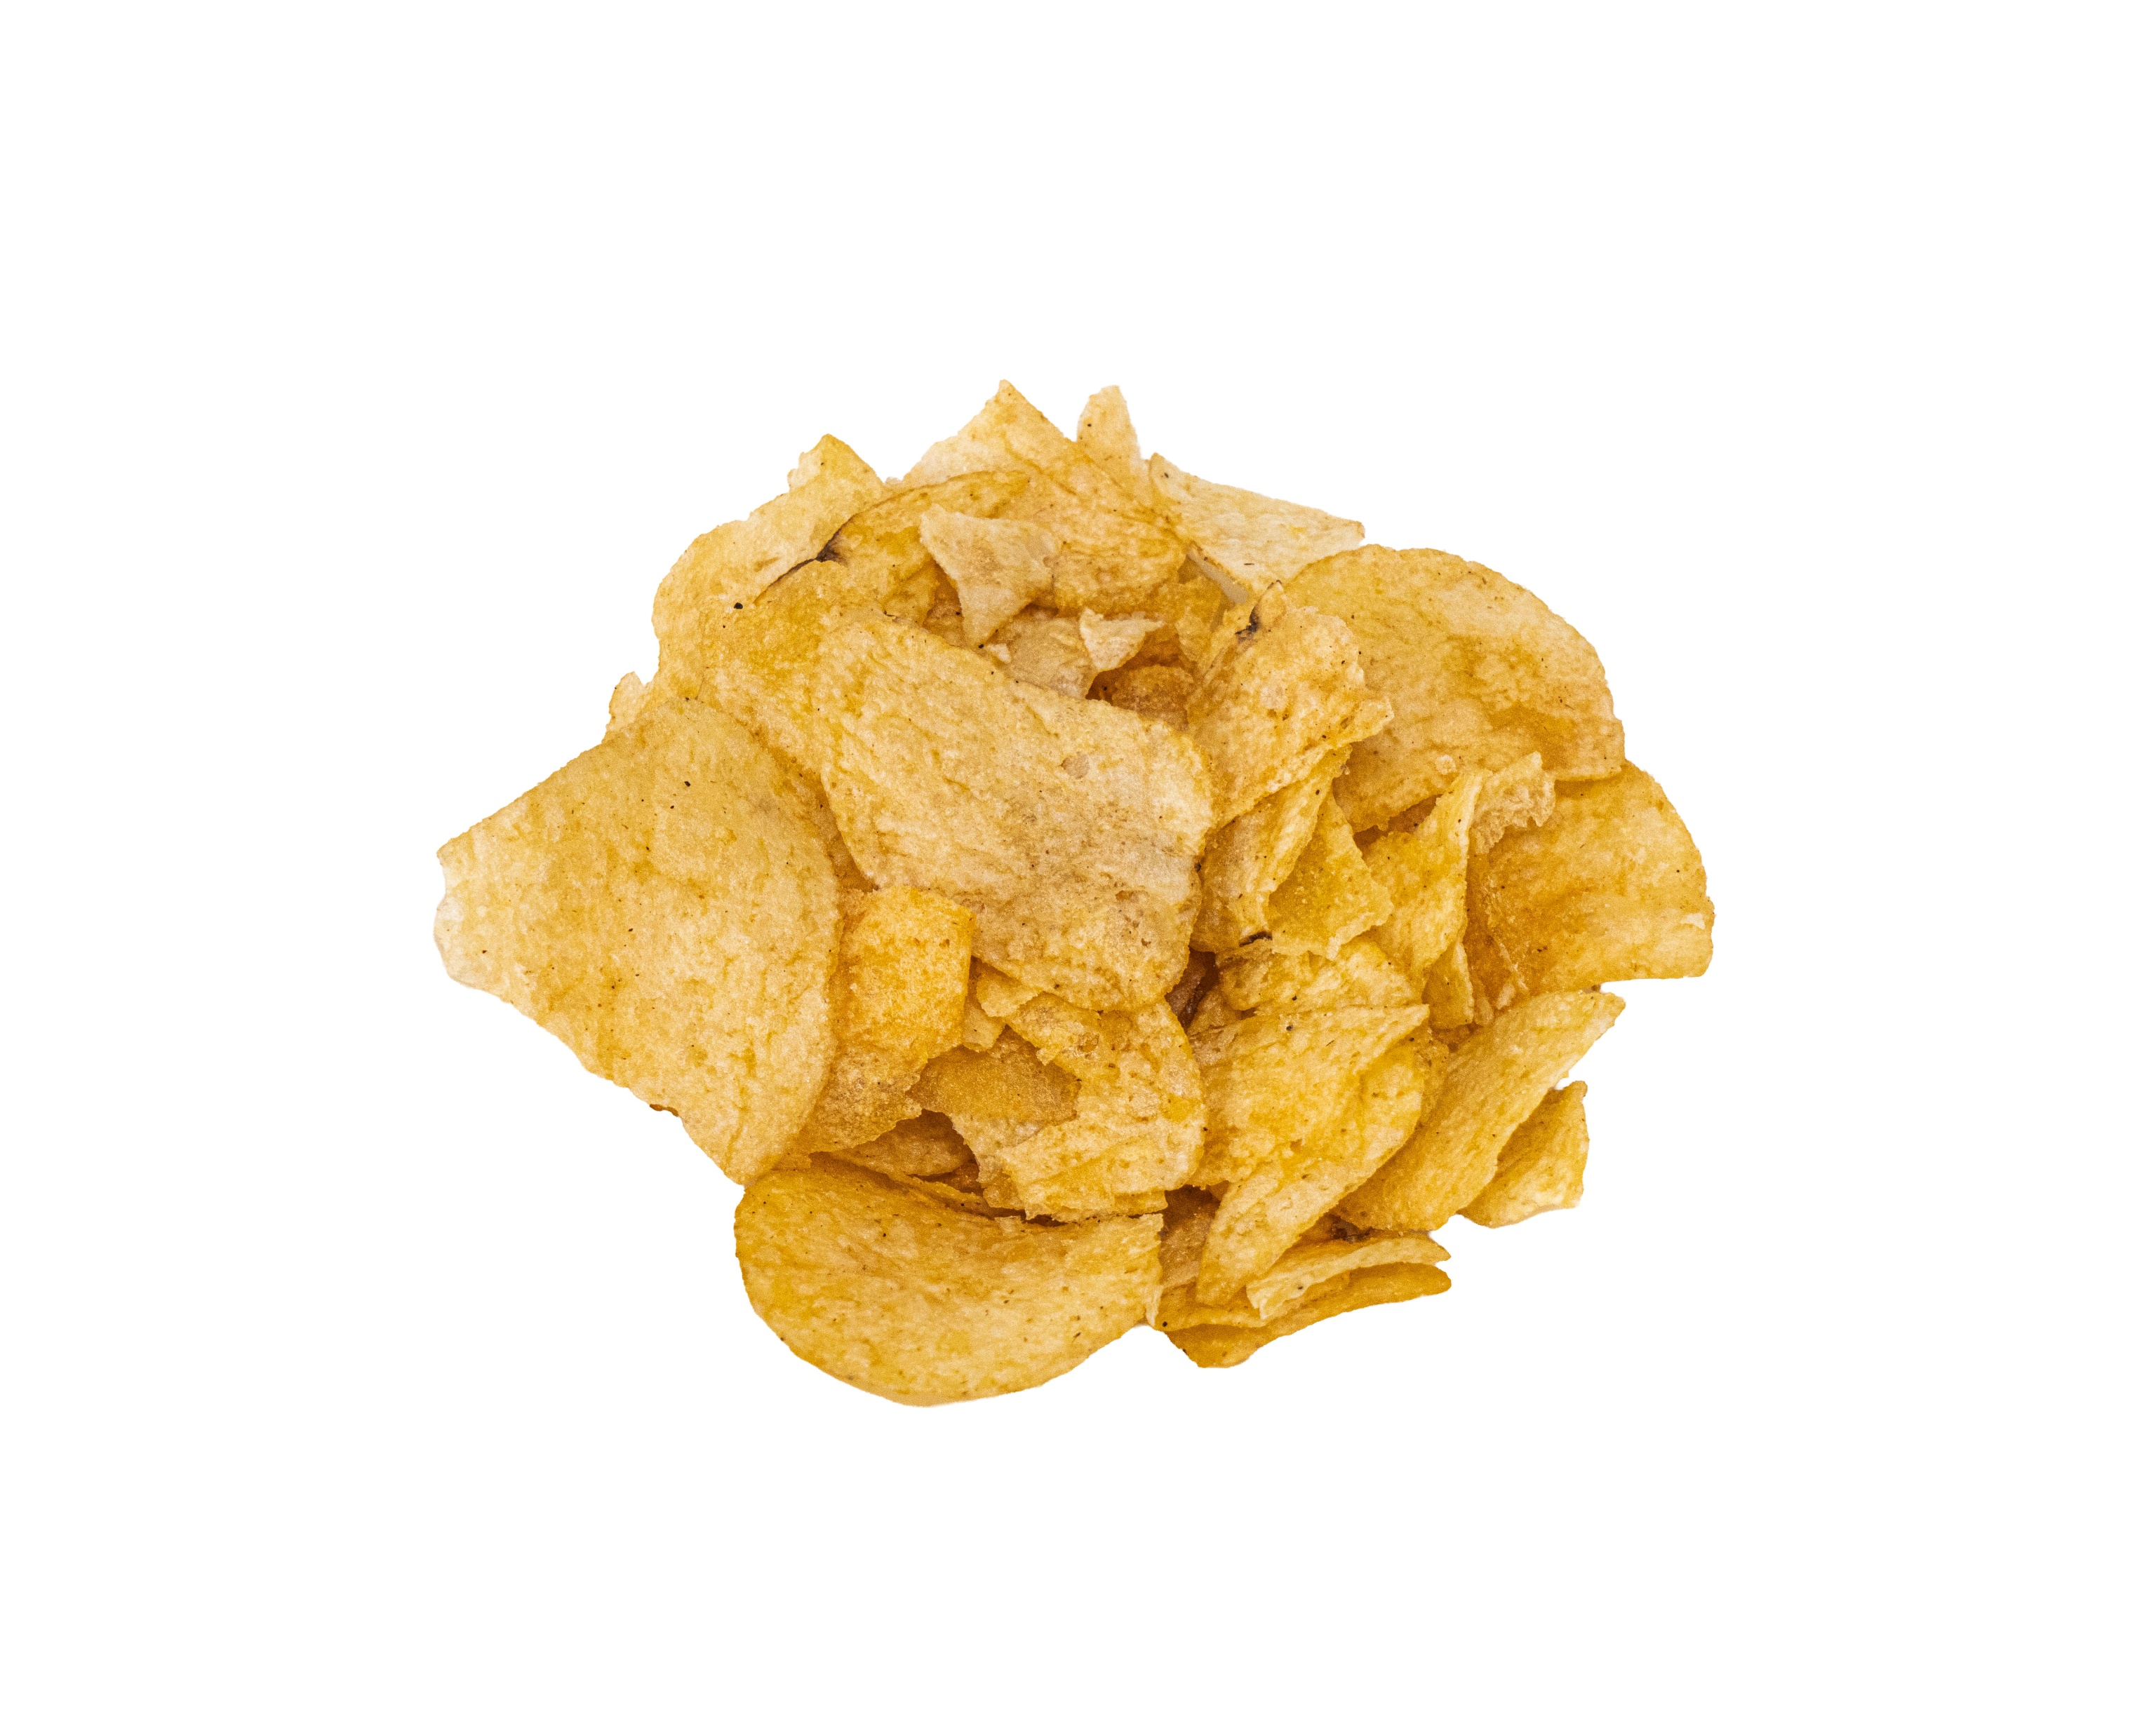
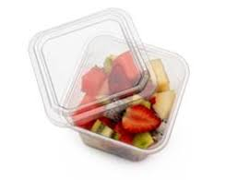
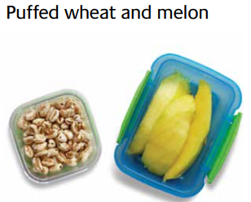
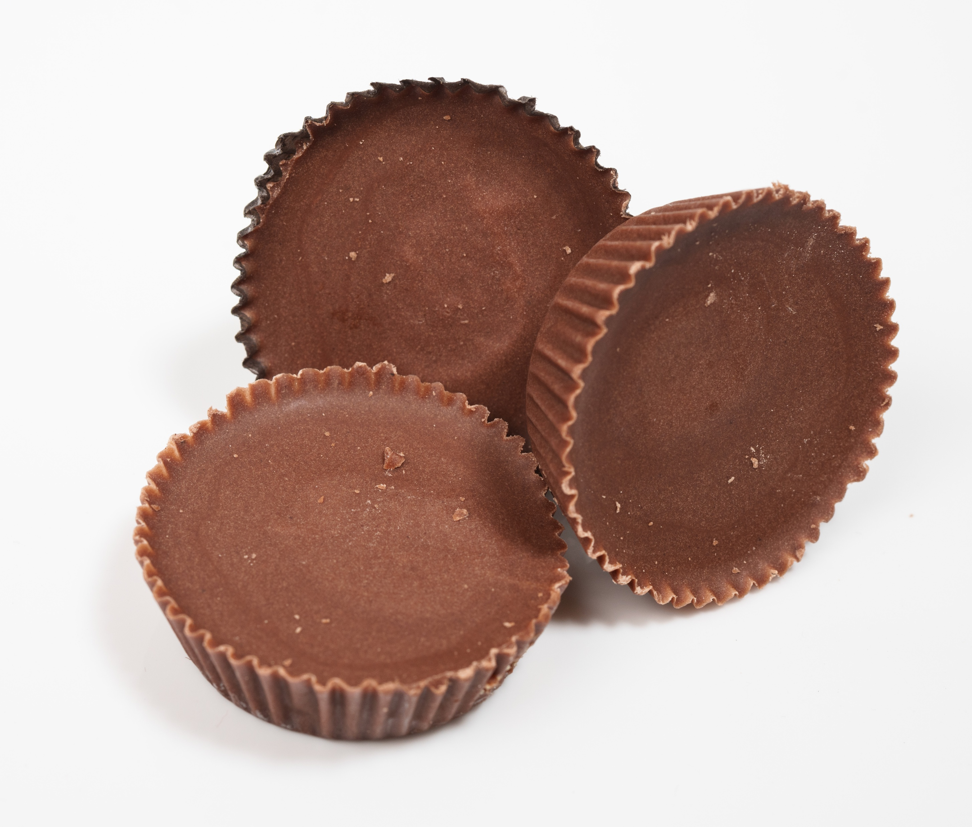

Which of these are a good snack?
Not suitable snack
Suitable snack and drinks

Slide 21
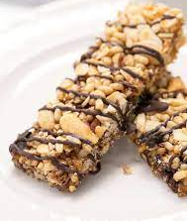
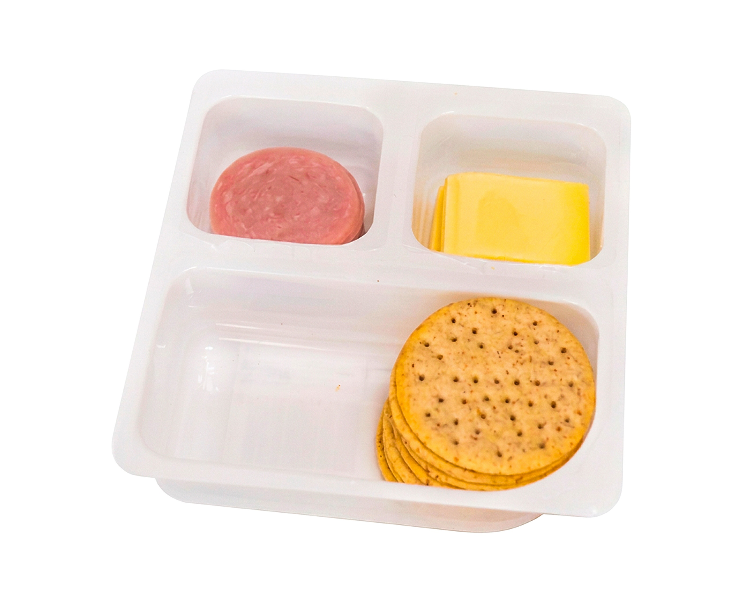
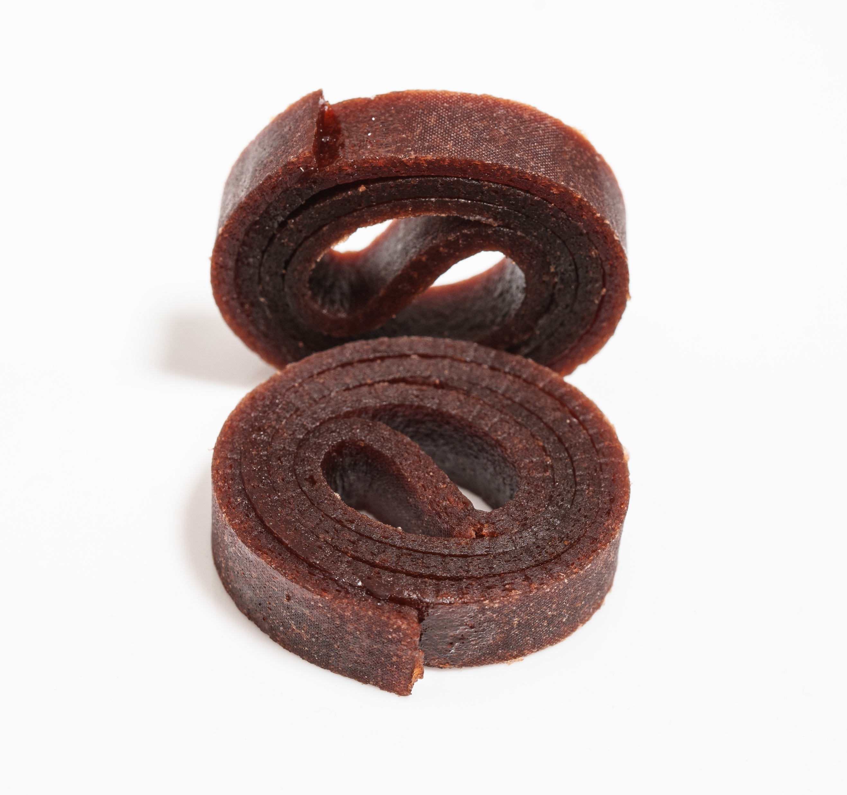
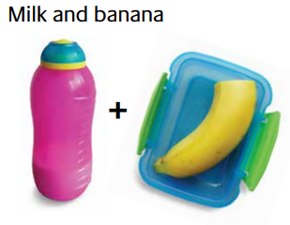
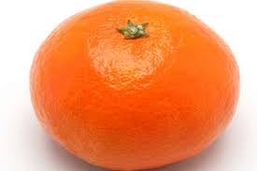
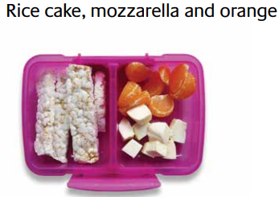
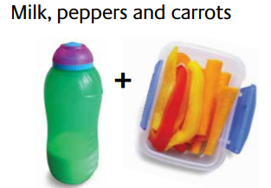
Which of these are a good snack?
Not suitable snack
Suitable snack

Slide 22


Remember!
Everyone can do something to eat better.
What will you choose for snack next time?

Slide 23
Activity Healthy Eating with Fibre
Instructions
Split the class into five groups and provide each with a Blank Eatwell Guide and fibre cards.
Sort the cards into three piles based on the back colour: no colour (low fibre), orange (source of fibre), green (high fibre).
Explain the colour coding, then start with the no colour cards. Ask the children to place them on the correct food group on the Eatwell Guide. Discuss which foods are low in fibre, noting white bread, pasta, and some vegetables like cucumber.
Repeat the process with orange and green cards, encouraging reflection on which foods are good sources of fibre.
Where appropriate refer to the assembly presentation
Share & Reflection:
Compare wholemeal and white foods. Discuss how fibre content changes with simple swaps. Highlight that fibre is found in wholegrains, fruit and veg, and plant-based proteins.
Ask children to read the content of fibre for wholemeal vs white bread, cornflakes vs porridge, or white pasta vs wholemeal pasta.
Discuss how they can increase their fibre if they make simple swaps.
Discuss the content of fibre, which foods are high in fibre, and why. What have you noticed (e.g., vegetables are low, does this mean we don’t need to eat them)? Explain that F&V contain high percentage of water rather than dry foods such as porridge oat
How many food groups does it cover on the Eatwell Guide?
Resources
  5x Blank UK Eatwell Guides https://www.foodafactoflife.org.uk/media/2467/blank-eatwell-guide-ws-711c1.pdf
  5x Sets of Fibre cards https://www.foodafactoflife.org.uk/search-results?q=fibre
  1x A1 or A0 UK Eatwell Guide https://www.gov.uk/government/publications/the-eatwell-guide
  Information for the teacher: 1x Fibre February Teachers’ Guide https://www.foodafactoflife.org.uk/media/rhrj4cy0/fibre-february-tg-516ap-v3.pdf

Slide 24
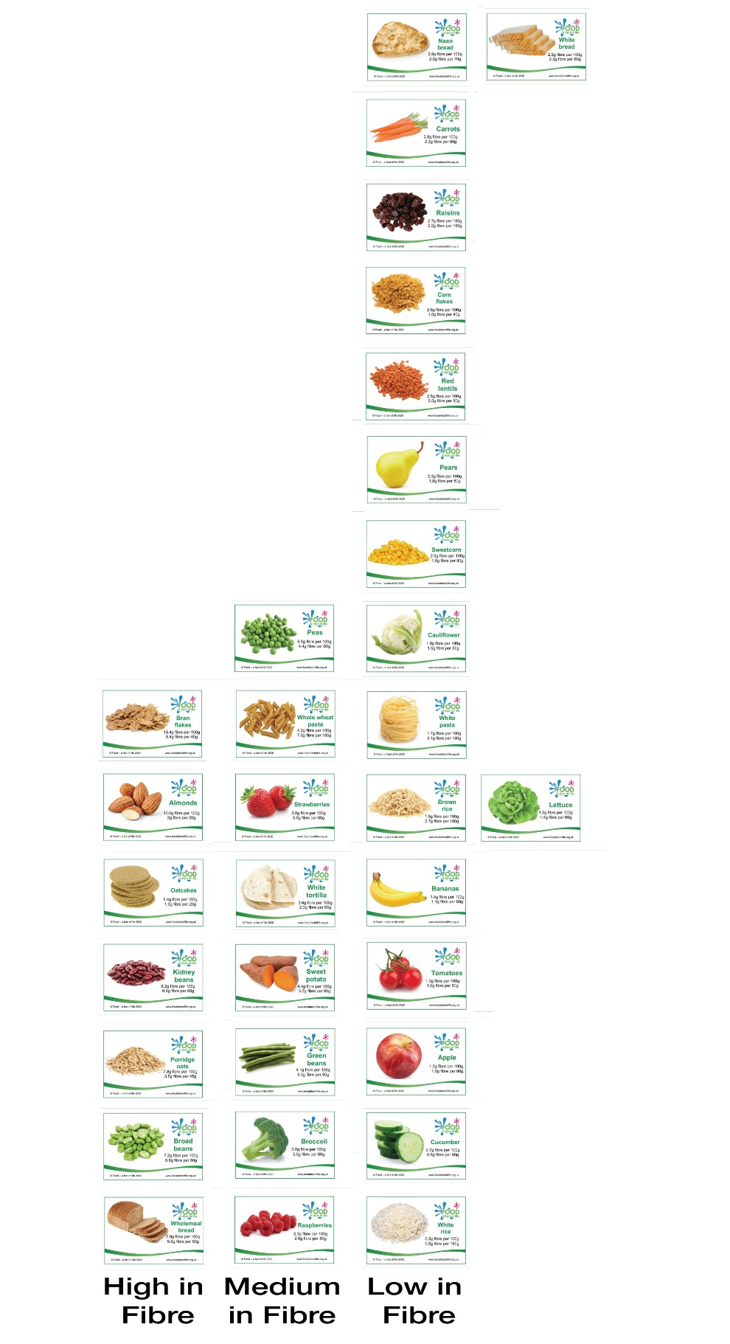

Slide 25
